Slide 1
PSYCHOLOGY AND YOU
BE A CERTIFIED COUNCELOR

Slide 2
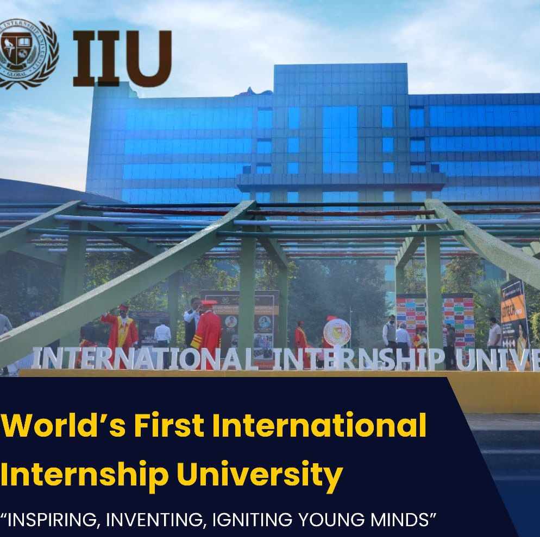
University Affliation for Vidhyaankur Education

Slide 3
Who can do this course
Trainers
Business Entrepreneurs
Students
Professionals
Teachers
Housewife
Marketing employees

Slide 4
Group of companies of Academy

Slide 5
WHAT IS PSYCHOLOGY? WHY TO BE A COUNCELOR?
PSYCHOLOGY COUNCELING IS BRANCH OF PSYCHOLGY FOCUS ON HELPING INDIVIDUALSAND GROUPS TO BE BETTER AND UNDERSTAND THEMSHELVES AND FACE THE SITUATION.
TO BE A COUNCELOR AND CAREER YOU WILL BE SOCIALISE AND UNDERSTAND THE SITUATION OF SURROUNDING AND BE A FACEVALUE HELPING HAND FOR SOCIETY WITH GREAT RESPECT ND DIGNITY .

Slide 6
COURSES
WORKSHOP FOR SCHOOL AND COLLEGES FOR AWARENESS OF PSYCHOLOGY AND YOU 10 HRS
5DAYS WITH CERTIFICATION
TOPICS
Introduction
Softskills
Awareness on stress
Self healing
Body language
Emotional intelligence
Adolance counceling/ child counceling
Habits
Situation handlling awareness

Slide 7
Term courses certification by IIU universitY
1 month cetification course REBT
Topics
introduction
Emotional intelligence
Developmental psychology
Practical assignments
Awareness on disorders

Slide 8
Syllabus
Short-term course in psychology 1 months 30 hrs
1) Introduction
2) Developmental psychology
3) personality development
4) Theory of Psychology
5) organizational management
6) awareness of disorders
7) Introduction to counseling
8) communication Development
9) psychology of individual difference
10) practical Research Assignment
long term course in psychology 3 months 90 hrs
1) Introduction
2) Developmental psychology
3) personality development
4) Theory of Psychology
5) organizational management
6) awareness of disorders
7) Introduction to counseling
8) communication Development
9) psychology of individual difference
10) Development of Psychological Thoughts.
11) Statistical Methods for Psychological Research.
12 ) Psychology of Individual Differences.
13) emotional intelligence
14) hyotesis testing
15)practical and assignment

Slide 9
Online and offline course
1 month course with certification 9999/-
3 months course with certification 25000/-

Slide 10
Mission and Vision
Make awareness for psychology disorders worldwide .
The key of Vidhyaankur to help all individual to get the answer for questions and make a strong belief in self to fight any hurdles of life.

